Slide 1

Automation Capstone Project
GlobalSQA_Banking_Project
(XYZ Banking Platform)
Bhavya Gupta
Superset ID: 3387777
Email: bhavya5883338@gmail.com
Java Selenium Batch 4

Slide 2

Table Of Content
Project Objectives
Framework Architecture
Driver Manager Util
The Feature Files (BDD)
The Runner Class
Step Definitions Classes
Page Objects Modal Classes(POM)
Util Classes
Console Output
Hooks
Report
Future Scope & Conclusion
GitHub Repository

Slide 3
Project Objectives
To design and implement a BDD (Behavior-Driven Development) framework using Cucumber and Selenium.
To automate key test scenarios, including customer creation, account management, deposits, and withdrawals.
To create a Page Object Model (POM) for better code organization and maintainability
To generate advanced test reports with Extent Reports, including screenshots for every validation step.
To build a framework capable of parallel test execution to reduce run time.

Slide 4
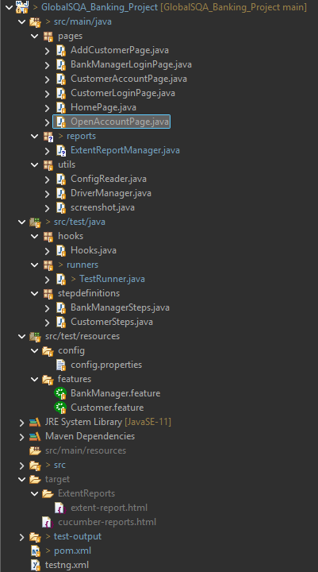
Framework Architecture
Page Object Model (POM): Each web page is represented as a separate class, encapsulating its elements and actions.
Step Definitions: "Glue" code that connects plain-text Gherkin steps to Java automation logic
DriverManager: A centralized utility to manage WebDriver instances using ThreadLocal for thread safety.
Step Definitions: "Glue" code that connects plain-text Gherkin steps to Java automation logic.
Feature Files: Human-readable test cases written in Gherkin syntax (Given-When-Then).
Hooks: Manages setup and teardown procedures for tests, including browser launch/close and report initialization.
Utilities: Includes helpers like a ConfigReader or managing test data and configurations.

Slide 5
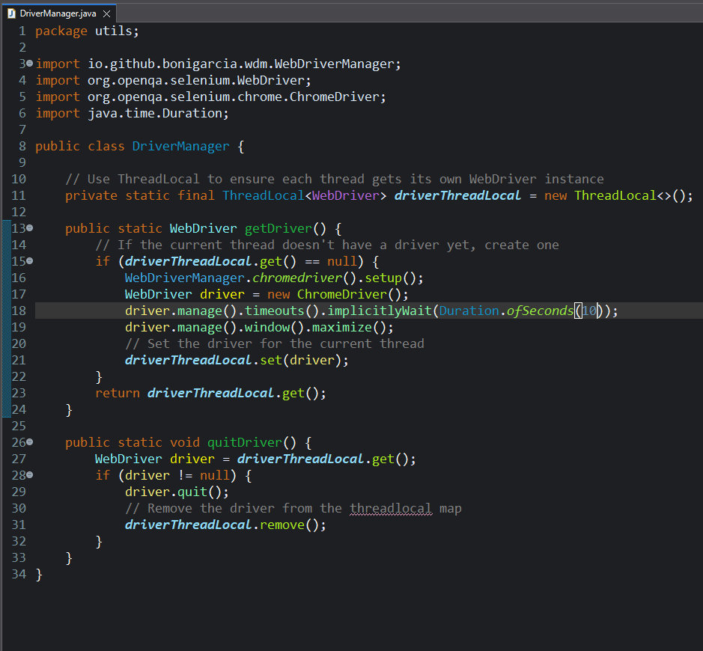
DriverManager Util
This is a centralized utility class that manages the entire lifecycle of the WebDriver, from setup to teardown.
It uses ThreadLocal to provide an isolated browser instance for each test thread, making the framework thread-safe for parallel execution.

Slide 6
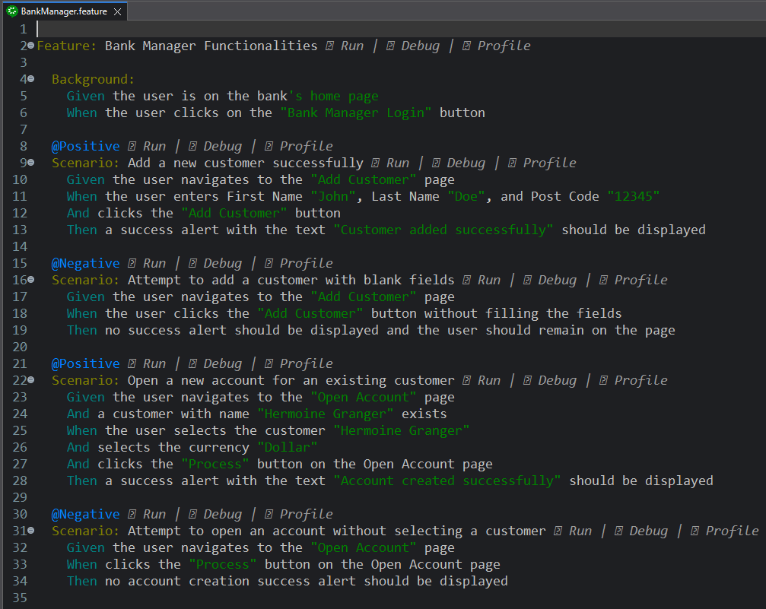
The Feature Files (BDD)
Our Program contains the following Feature Files :
BankManager.feature
Test Case 1. Add New Customer (Manager Login)
Positive: Enter valid customer details (First Name, Last Name, Post Code) → Customer created successfully.
Success Message: “Customer added successfully
Negative: Leave mandatory fields empty → No success alert displayed
Test Case 2. Open New Account (Manager Login)
Positive: Select existing customer, choose Currency (Dollar/Pound/Rupee), click Process → Account created successfully.
Success Message: “Account created successfully
Negative: Do not select customer and currency → No account creation success alert displayed.

Slide 7
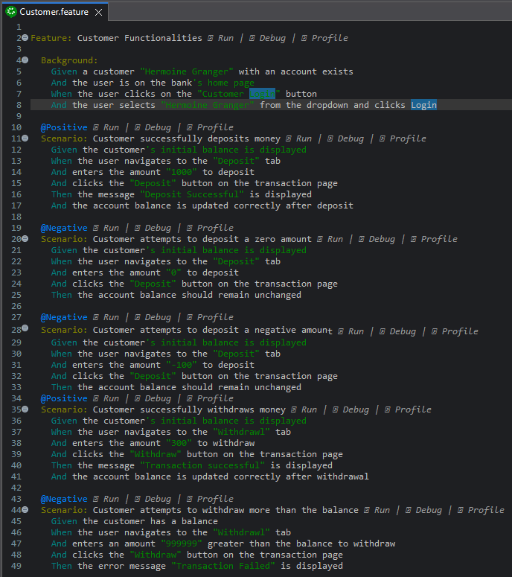
The Feature Files (BDD)
Our Program contains the following Feature Files :
BankManager.feature
Test Case 3. Deposit Amount (Customer Role)
Positive: Enter valid amount (e.g., 1000) → Amount added successfully to balance.
Success Message: “Deposit Successful”.
Negative: Enter 0 or negative value → then account balance remain unchanged.
Test Case 4. Withdraw Amount (Customer Role)
Positive: Enter valid withdrawal amount less than or equal to balance → Balance updated successfully.
Success Message: “Transaction Successful”
Negative: Enter amount greater than balance → Error Message: “Transaction Failed.”

Slide 8
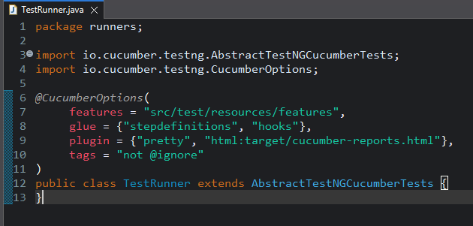
The Runner Class
This class serves as the primary execution point, using TestNG to run all the Cucumber scenarios.
The @CucumberOptions annotation is used to configure the test suite, linking the feature files to the step definition "glue" code and specifying the report formats.

Slide 9
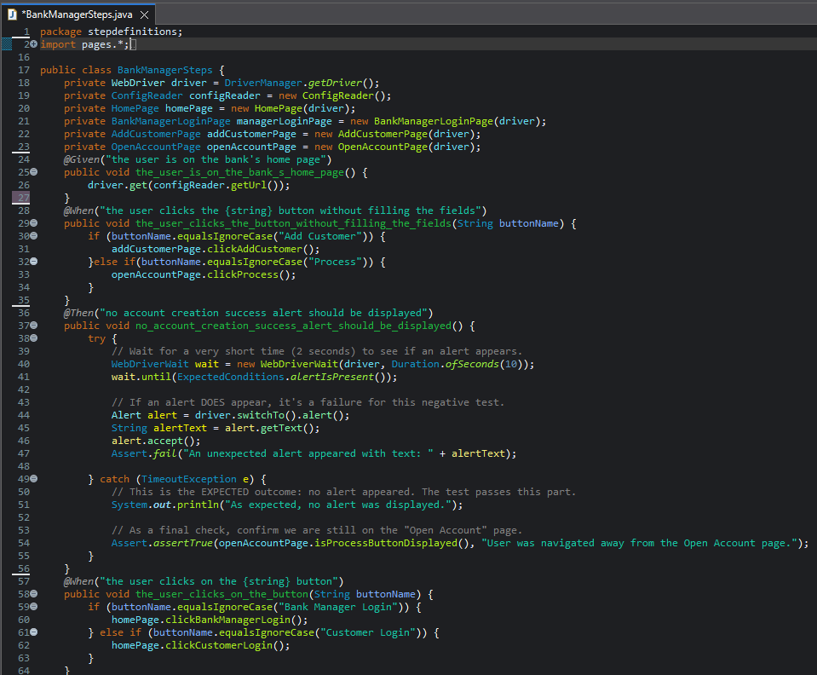
BankManagerSteps.java

Slide 10
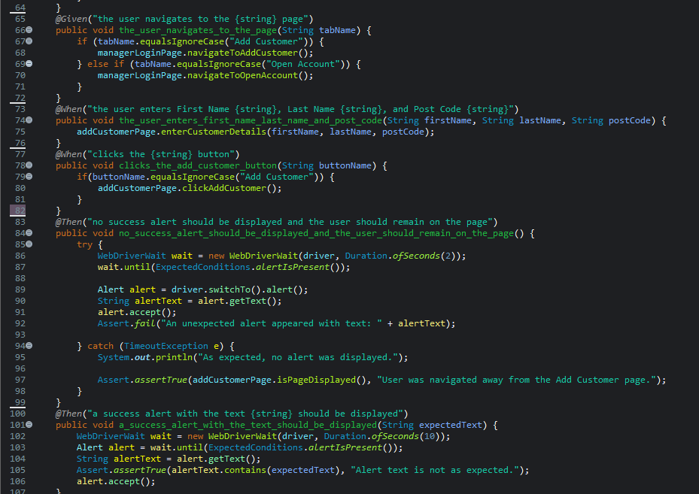

Slide 11
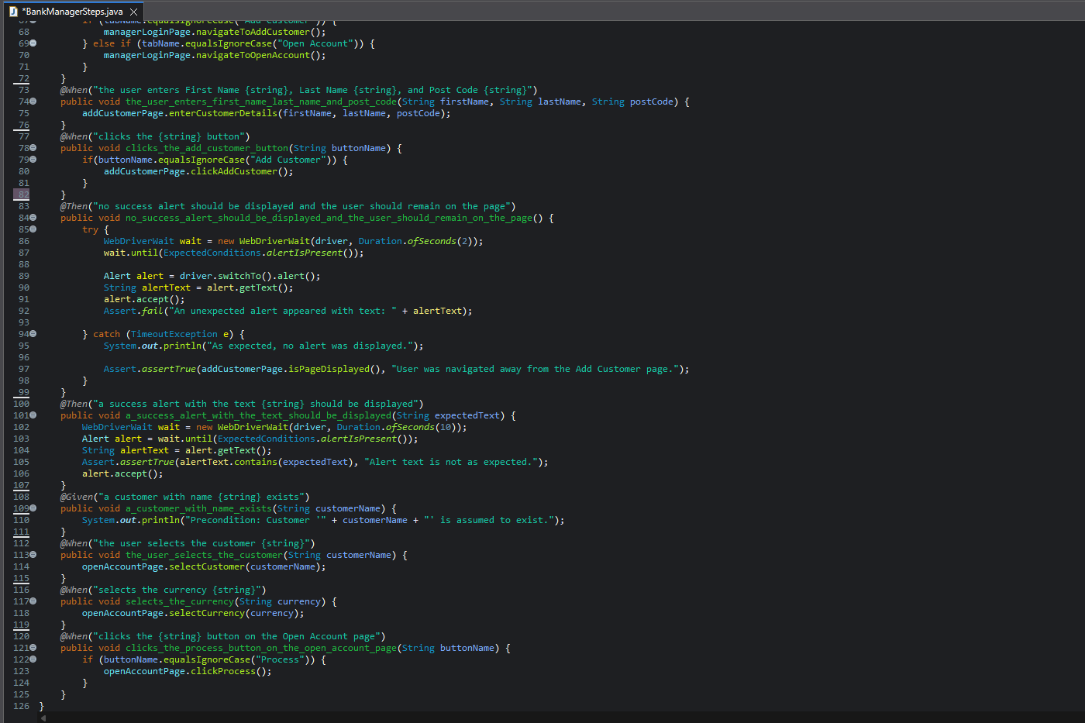

Slide 12
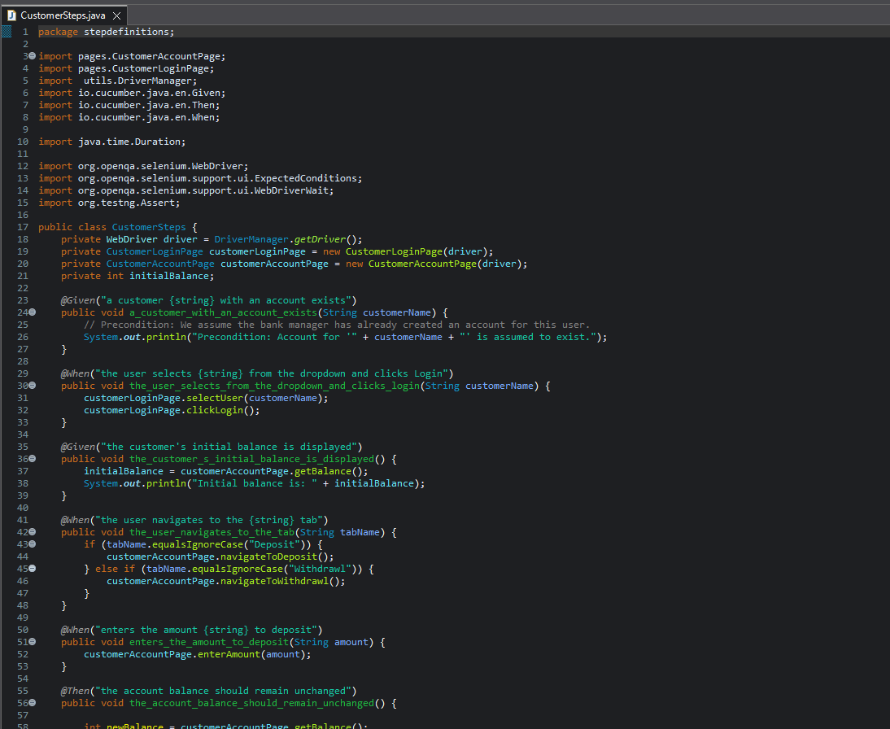
CustomerSteps.java

Slide 13
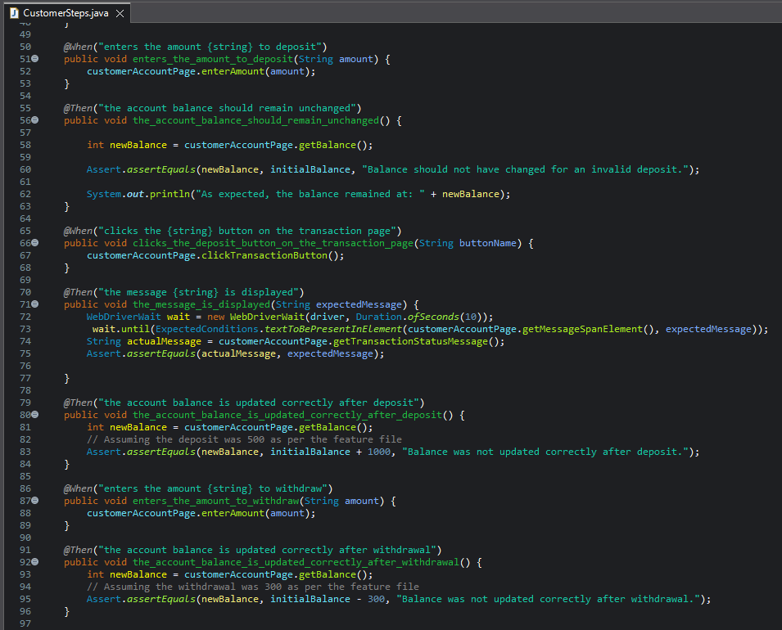

Slide 14
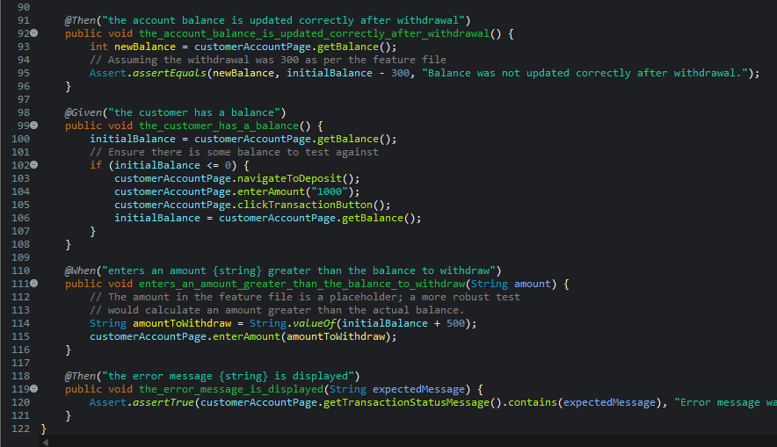

Slide 15
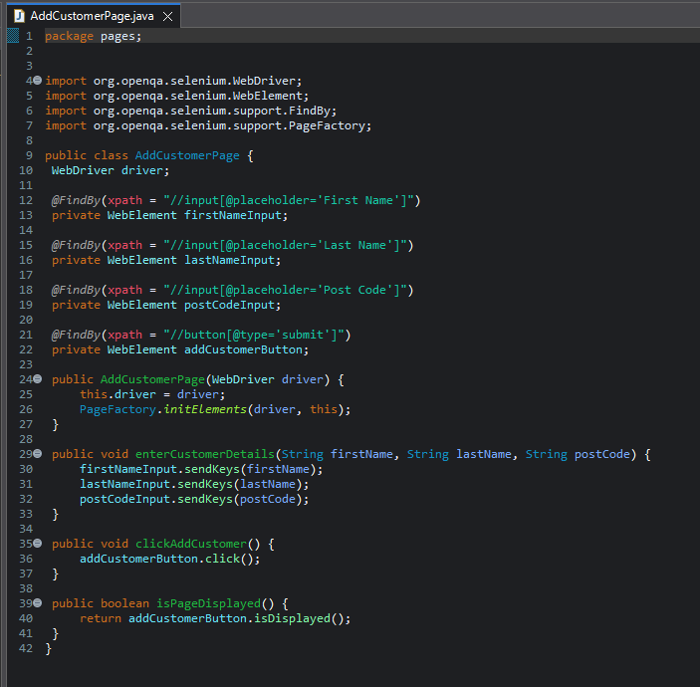
POM Classes:
AddCustomerPage.java

Slide 16
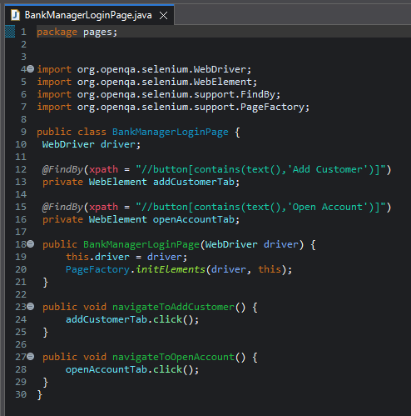
BankManagerLoginPage.java

Slide 17
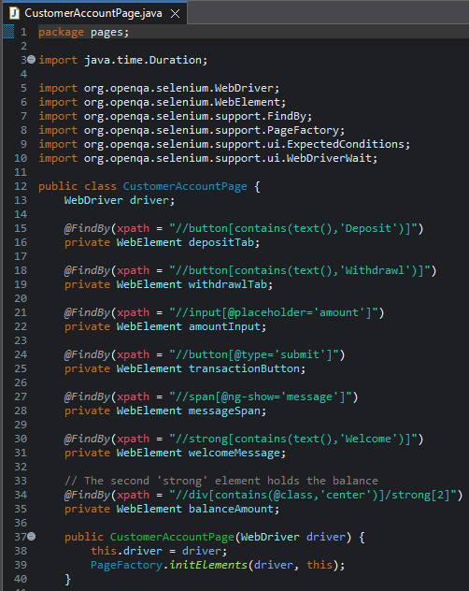
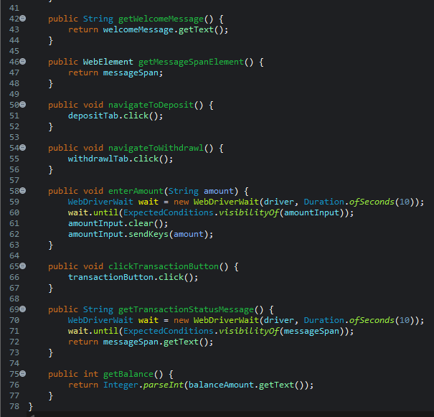
CustomerAccountPage.java

Slide 18
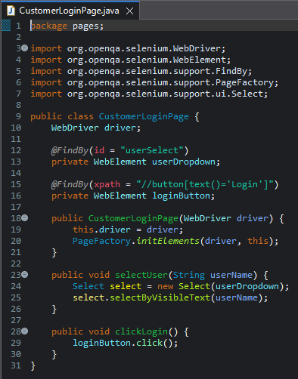
CustomerLoginPage.java

Slide 19
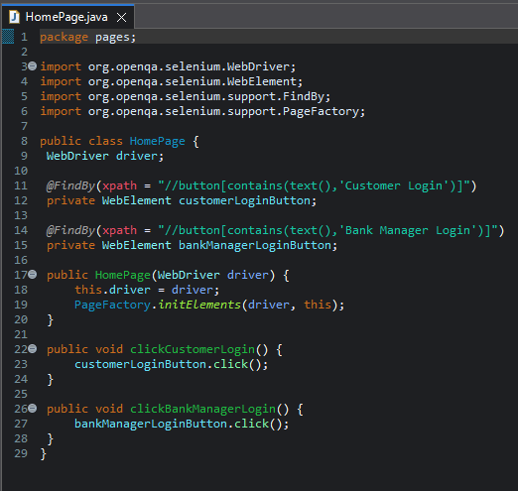
HomePage.java

Slide 20
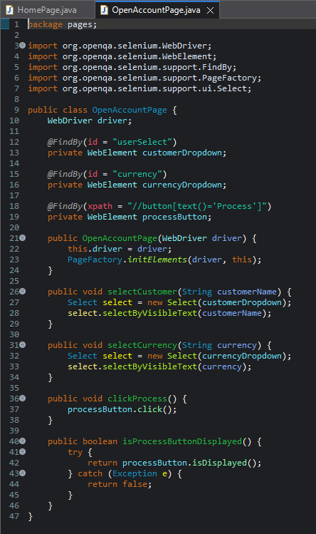
OpenAccountPage.java

Slide 21
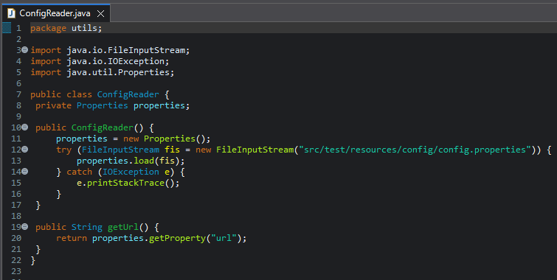
Util Classes
ConfigReader.java

Slide 22
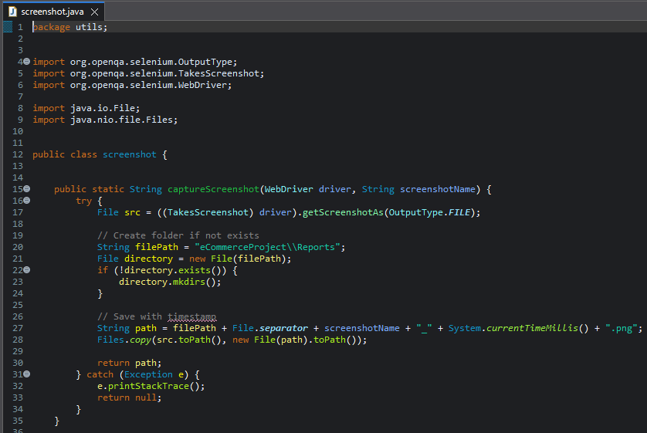
Screenshot.java

Slide 23
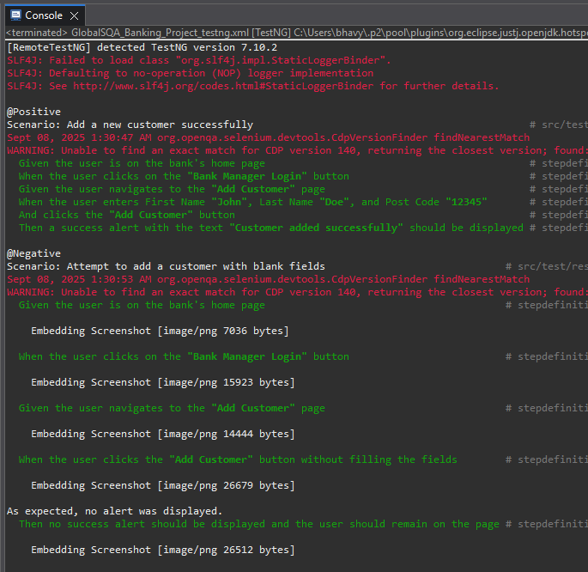
Console Output:

Slide 24
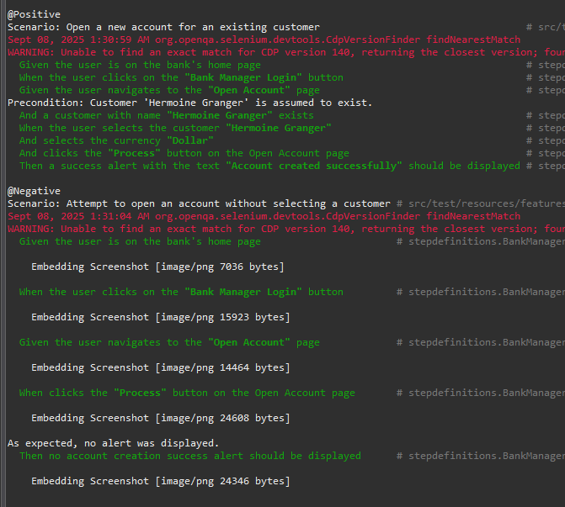

Slide 25
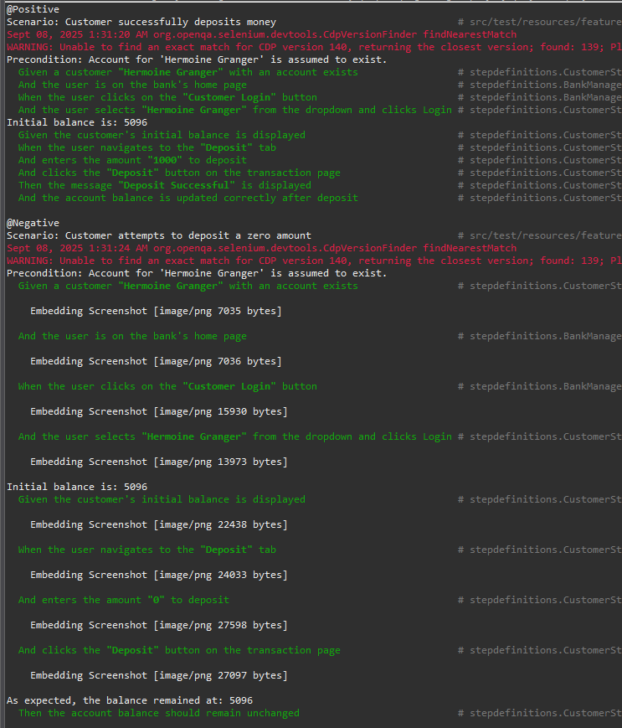

Slide 26
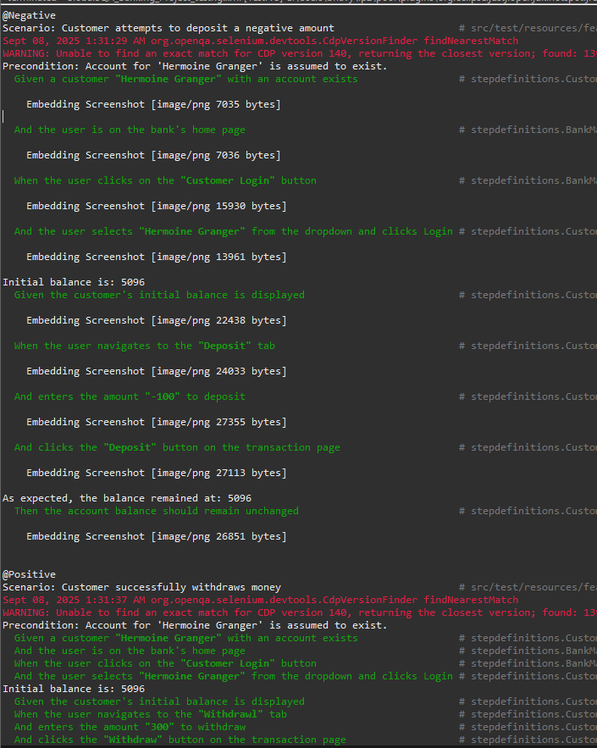

Slide 27
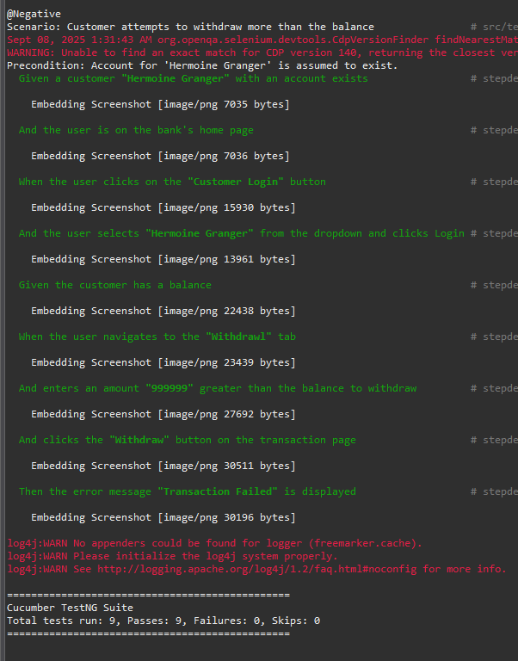

Slide 28
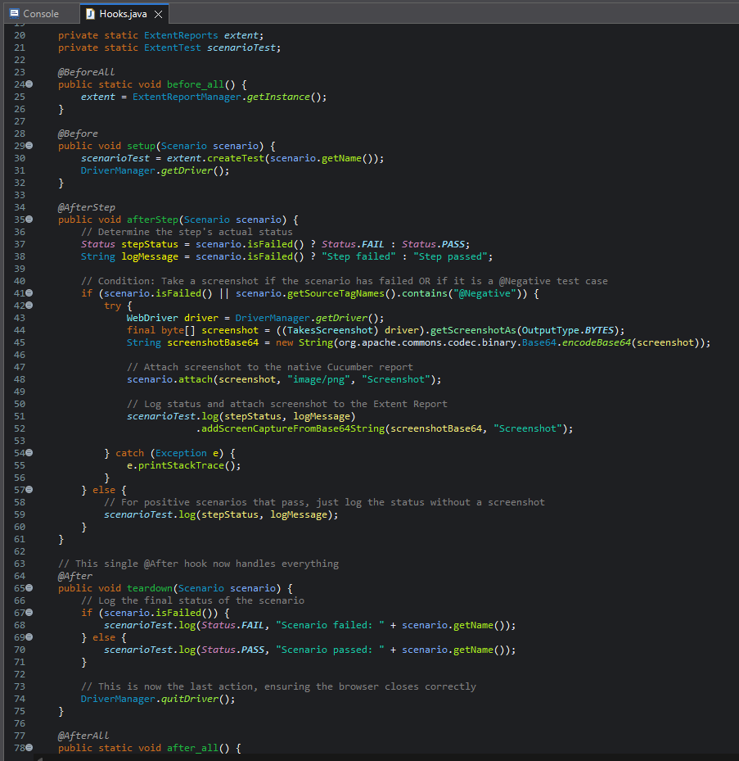
Hooks.java

Slide 29
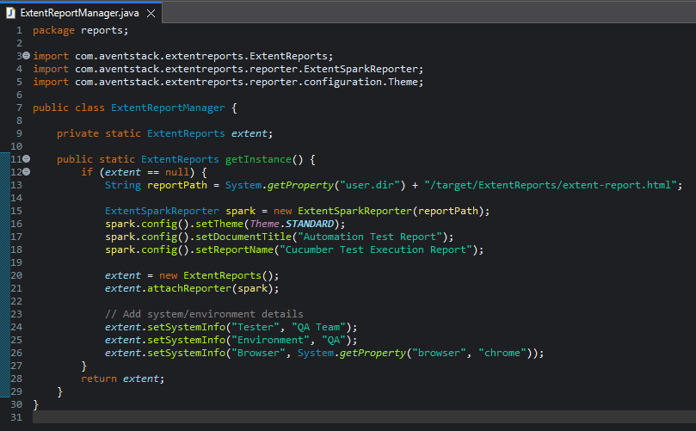
ExtentReport

Slide 30
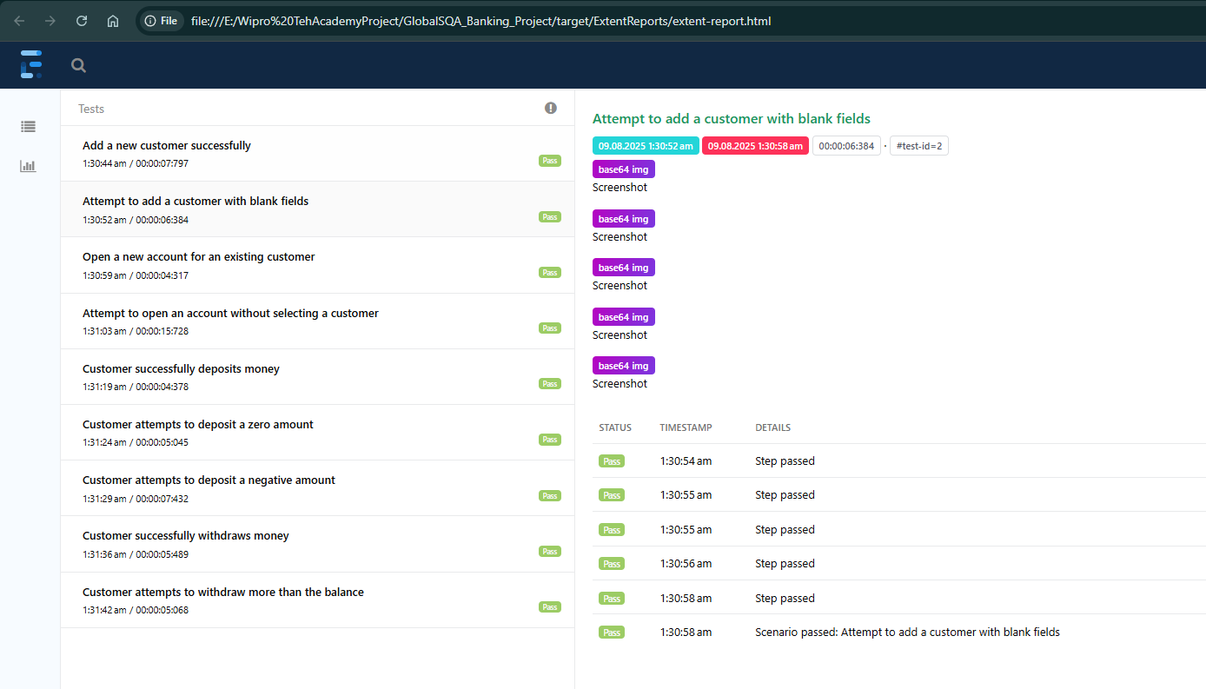
Report

Slide 31
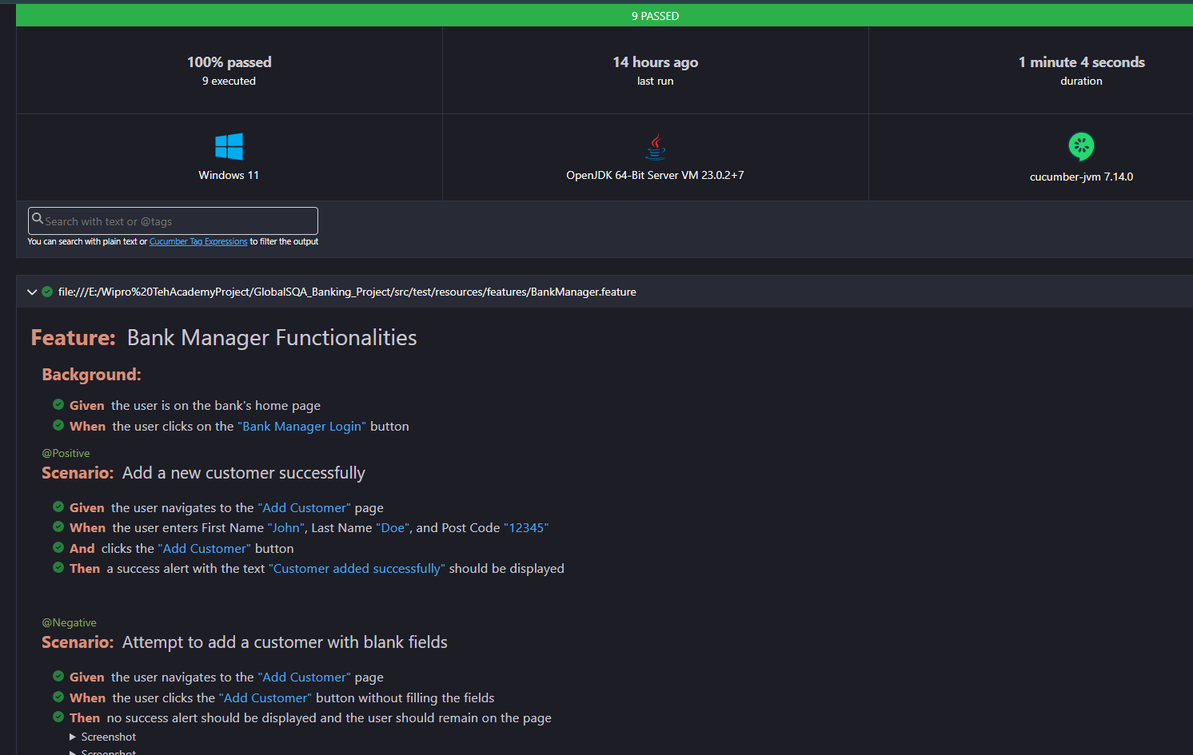

Slide 32
Future Scope
CI/CD Integration: Integrate the framework with a CI/CD tool like Jenkins to enable continuous testing.
Data-Driven Testing: Implement logic to read test data from external files (like Excel or CSV) to test with multiple datasets.
API Integration: Add API tests to set up test data (e.g., create customers via API) to make UI tests faster.
Conclusion
A robust and scalable test automation framework was successfully created using Java, Selenium, and Cucumber.
The framework effectively automates critical test scenarios, improving test coverage and efficiency.
Expand Test Coverage: Automate more scenarios, including negative test cases, payment gateways, and user account functionalities.

Slide 33

GitHub Repository
Redirect to the Repository.
https://github.com/bhavyagg90/GlobalSQA_Banking_Project

Slide 34


